Slide 1
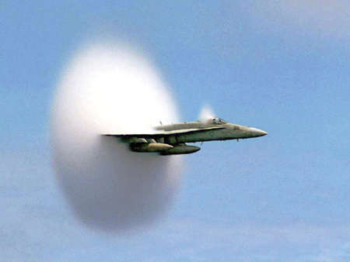
C H A P T E R 17
Waves and Sound
F/A 18 fighter jet emerges from a cloud caused when it breaks through the sound barrier.
https://www.youtube.com/watch?v=gWGLAAYdbbc
Speed of sound = 343 m/s = 768 MPH, at 20⁰C.
Speed of fighter jet = 1360 MPH + (Boeing)

Slide 2
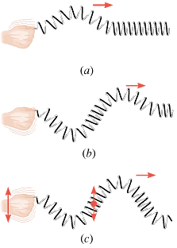
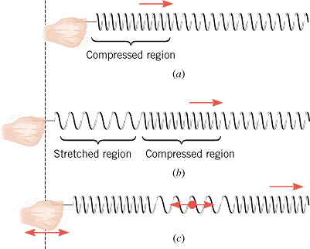
The Nature of Waves
Wave is a traveling disturbance. Wave carries energy from place to place. There are two basic types of waves:
Transverse waves
Longitudinal Waves
The disturbance is perpendicular to the direction of travel of the wave.
Examples: Light wave, waves on a guitar string.
The disturbance is parallel to the direction of travel of the wave.
Example: Sound wave in air.

Slide 3
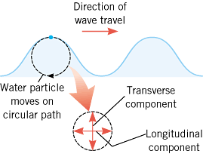
Water Waves
Water waves are partly transverse and longitudinal.
Dominoe Toppling:
Human wave at a sport stadium:

Slide 4
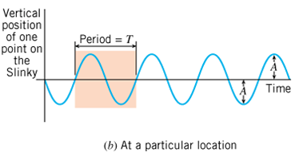
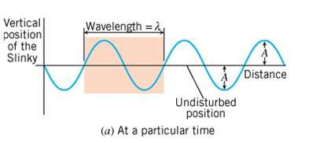
Periodic Waves: waves that repeat
The amplitude, A is the maximum disturbance.
The wavelength, λ is the horizontal length of one cycle of the wave.
The period, T is the time required for one complete up/down cycle of the wave.
The frequency, f is the number of waves per unit time, f=1/T.
Wave Speed =

Slide 5
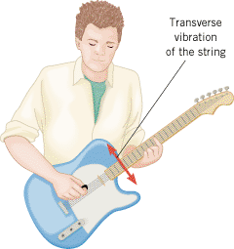
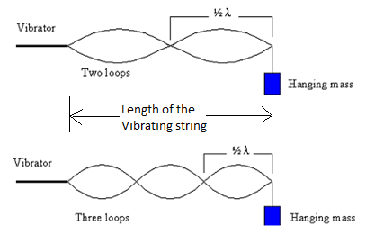
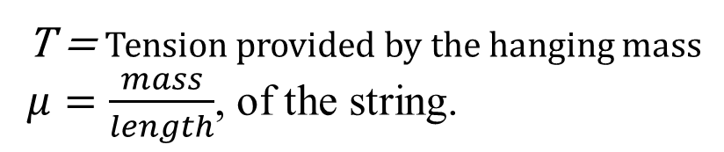
The Speed of a Wave on a String
T = Tension provided by the hanging mass
$μ=\frac{mass}{length}$, of the string.

Slide 6
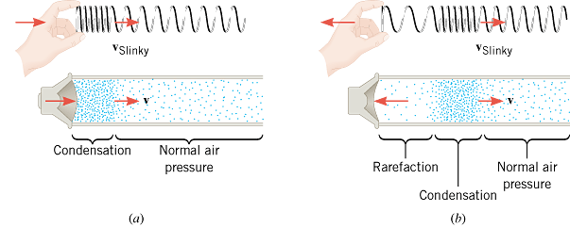
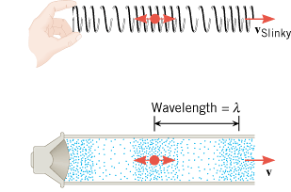
The Nature of Sound
Longitudinal Sound Waves
Sound in air is a longitudinal wave that is created by a vibrating object, such as a guitar string, the human vocal cords, or the diaphragm of a loudspeaker.
Sound cannot propagate in a vacuum.
Bell in a vacuum

Slide 7
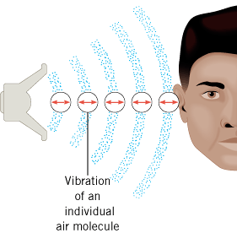
How do we hear?

Slide 8
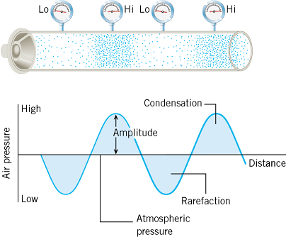
Wave Picture

Slide 9
The Frequency of a Sound Wave
Audible Range: 20 Hz ----- 20,000 Hz.
Infrasonic waves: Sound waves with frequencies < 20 Hz.
Rhinoceroses use infrasonic frequencies as low as 5 Hz to call one another
Ultrasonic waves: Sound waves with frequencies > 20,000 Hz.
Bats use ultrasonic frequencies up to 100 kHz for locating their food sources and navigating.

Slide 10
Objective and Subjective properties of sound
Objective properties can be measured, used in physics.
Subjective properties are subjective to the person, used in music.
Objective property
Subjective quality
Frequency
Pitch
Intensity
Loudness
Waveform
Tymbre or Quality

Slide 11
Speed of Sound in an ideal gas
γ = 1.40 (ratio of specific heats for air)
m = 4.8 x 10⁻²⁶ kg (average molecular mass of air)
k = 1.38 x 10⁻²³ J/K (Boltzmann constant)
T= temperature in Kelvin
Gases Speed of Sound (m/s)
Air (0 °C) | 331
Air (20 °C) | 343
Carbon dioxide (0 °C) | 259
Oxygen (0 °C) | 316
Helium (0 °C) | 965
Liquids Speed of Sound (m/s)
Chloroform (20 °C) | 1004
Ethyl alcohol (20 °C) | 1162
Mercury (20 °C) | 1450
Fresh water (20 °C) | 1482
Seawater (20 °C) | 1522
Solids Speed of Sound (m/s)
Copper | 5010
Glass (Pyrex) | 5640
Lead | 1960
Steel | 5960
Inhaling Helium and Sulfur Hexafluoride

Slide 12
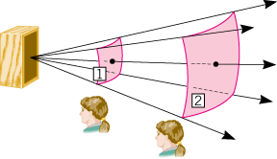

Sound Intensity
The sound intensity I is defined as the sound power P that passes perpendicularly through a surface divided by the area A of that surface:
The unit of sound intensity is power per unit area, or W/m².

Slide 13
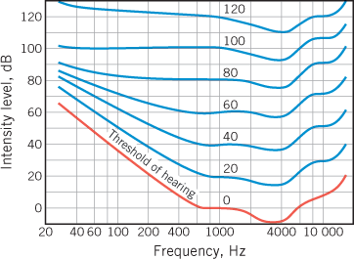
Human Ear and Sensitivity
Audible frequency range: 20 Hz – 20,000 Hz
Audible intensity range: 10^{–12} W/m² - 10 w/m²
10^{–12} W/m² = Threshold of hearing
10 W/m² = Threshold of pain

Slide 14

Decibels
The decibel (dB) is a measurement unit used when comparing two sound intensities.
The intensity level β (expressed in decibels) relative to the threshold of hearing, I_{o} is defined as follows:

Slide 15
Typical Sound Intensities and Intensity Levels Relative to the Threshold of Hearing
Intensity I (W/m²)
Intensity Level β (dB)
Threshold of hearing
1.0 × 10⁻¹²
0
Rustling leaves
1.0 × 10⁻¹¹
10
Whisper
1.0 × 10⁻¹⁰
20
Normal conversation (1 meter)
3.2 × 10⁻⁶
65
Inside car in city traffic
1.0 × 10⁻⁴
80
Car without muffler
1.0 × 10⁻²
100
Live rock concert
1.0
120
Threshold of pain
10
130

Slide 16
Sonic Boom
https://www.youtube.com/watch?v=1pf-Is2S1_Q&t

Slide 17
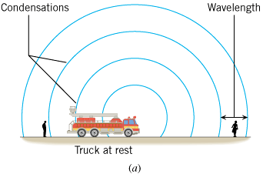
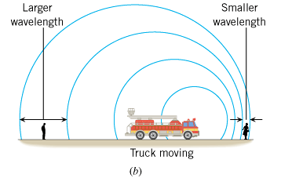
The Doppler Effect
The Doppler effect is the change in frequency or pitch of a wave for an observer moving relative to its source.

Slide 18
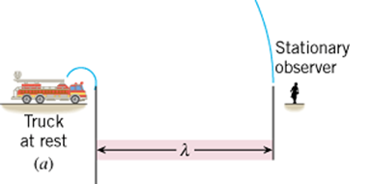
Source Moving Towards Observer

Slide 19
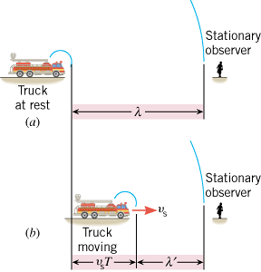
Source Moving Towards Observer

Slide 20
Source Moving Towards Observer

Slide 21
Source Moving Towards Observer

Slide 22
Source Moving
–v_{s} ….when the source moves towards the observer.
+v_{s} .… when the source moves away from the observer.

Slide 23
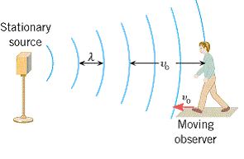
Moving Observer

Slide 24
Moving Observer

Slide 25
Moving Observer
In the above equation +v_{o} is used when the observer moves towards the source and –v_{o} is used when the observer moves away from the source.

Slide 26
Doppler Effect
General Case
+v_{o} is used when the observer moves towards the source,
–v_{o} is used when the observer moves away from the source,
–v_{s} is used when the source moves towards the observer, and
+v_{s} is used when the source moves away from the observer.

Slide 27
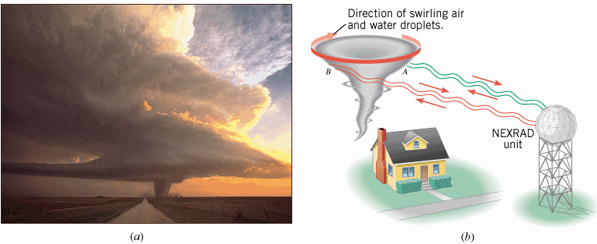
Application of Doppler Effect
Nexrad: Next Generation Weather Radar

Slide 28
Applications of Sound in Medicine
Ultrasonic Scanner
The cavitron ultrasonic surgical aspirator (CUSA)
Bloodless surgery: High-intensity focused ultrasound (HIFU)
The Doppler flow meter

Slide 29
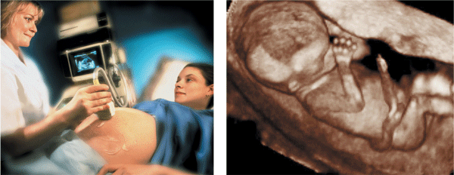
Ultrasonic Scanner

Slide 30
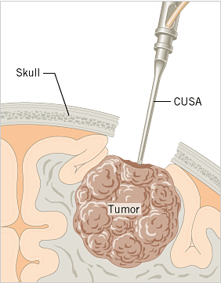
The cavitron ultrasonic surgical aspirator (CUSA)
Neurosurgeons use a cavitron ultrasonic surgical aspirator (CUSA) to “cut out” brain tumors without adversely affecting the surrounding healthy tissue.

Slide 31
Bloodless surgery
High-intensity focused ultrasound (HIFU)
Another application of ultrasound is in a new type of bloodless surgery, which can eliminate abnormal cells, such as those in benign hyperplasia of the prostate gland.
This technique is known as HIFU (high-intensity focused ultrasound). It is analogous to focusing the sun’s electromagnetic waves by using a magnifying glass and producing a small region where the energy carried by the waves can cause localized heating. Ultrasonic waves can be used in a similar fashion.
The waves enter directly through the skin and come into focus inside the body over a region that is sufficiently well defined to be surgically useful. Within this region the energy of the waves causes localized heating, leading to a temperature of about 56 °C (normal body temperature is 37 °C), which is sufficient to kill abnormal cells. The killed cells are eventually removed by the body’s natural processes.

Slide 32
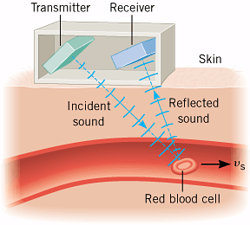
Doppler Flow Meter
A Doppler flow meter measures the speed of red blood cells.

